Slide 1
October 2024
EMHS Board Communique
The latest news, views, and announcements
This communique highlights key discussions and considerations of the EMHS Board meeting held on Tuesday 29 October 2024 at EMHS Chief Executive Office.
Board Members Present:
Ms Pia Turcinov AM, Board Chair
Dr Denise Glennon, Deputy Board Chair
Mr Peter Forbes, Board Member
Dr Steven Patchett, Board Member
Ms Melissa Grove, Board Member
Ms Vanessa Elliott AM via Teams, Board Member
Mr Andrew Whitechurch, Board Member
Ms Elizabeth Koff, Board Member
Noongar Season: Kambarang
EMHS Board Leader Rounding:
The below Board Members visited the EMHS HIVE area:
Denise Glennon
Melissa Grove
Vanessa Elliott
Andrew Whitechurch

Slide 2
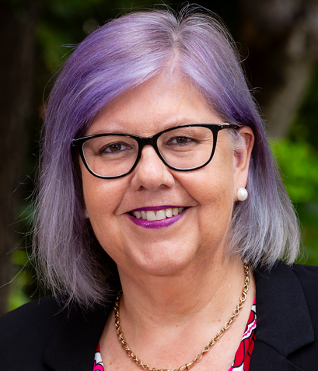
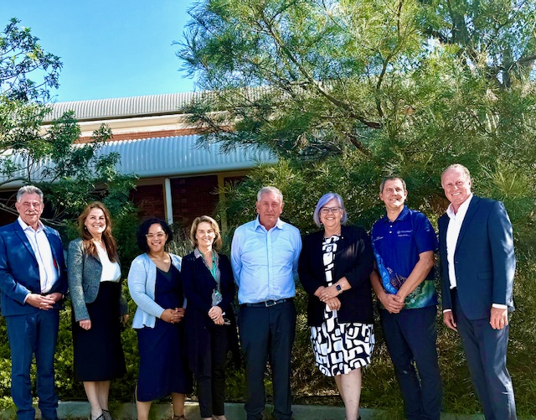
Board Chair – Ms Pia Turcinov
Ms Turcinov attended the Key Issues Meeting with the Director General, discussions were focused on the EMHS Annual Performance Review Report, EMHS Strategic Asset Plan and other key items.
Ms Turcinov attended the Monthly Ambulance Ramping Taskforce meeting, discussions included, updates on the Community Health Services Strategy Summary and Implementation Plan, WA Virtual Emergency Department (WAVED) Implementation Update and Key Performance Indicator (KPI) Performance Reporting.
Ms Turcinov attended the opening of Ellison House, a new Medical Respite Centre in a government owned building. Minister Sanderson and Minister Carey attended. Homeless Health Care CEO Alison Sayer led a walk through the facility with the former owners Brightwater Group, who was represented by Board Chair, Joanne Farrell.
EMHS Board Committee Reports
The Board discussed reports from the Chairs of the Board Safety & Quality Committee, Board Audit & Risk Committee and the Board Finance Committee:
Board Safety & Quality:
The Committee had an education session with the DoH on interpreting Statistic Process Control (SPC) Charts.
Board Audit & Risk:
The Committee Chair provided an overview of key matters arising from a meeting of the Health Service Provider Audit & Risk Committee Chair’s.
An overview was provided on the EMHS Cyber Security Directorate.
Board Finance:
The Committee discussed the EMHS financial matters for the month.
Left to right: Mr Ross Keesing - Board Member, Dr Lesley Bennett – Chief Executive, Ms Melissa Grove – Board Member, Dr Denise Glennon – Deputy Board Chair, Mr Peter Forbes – Board Member, Ms Pia Turcinov – Board Chair, Mr Neil Cowan – Executive Director, AKG, Mr Andrew Whitechurch – Board Member

Slide 3
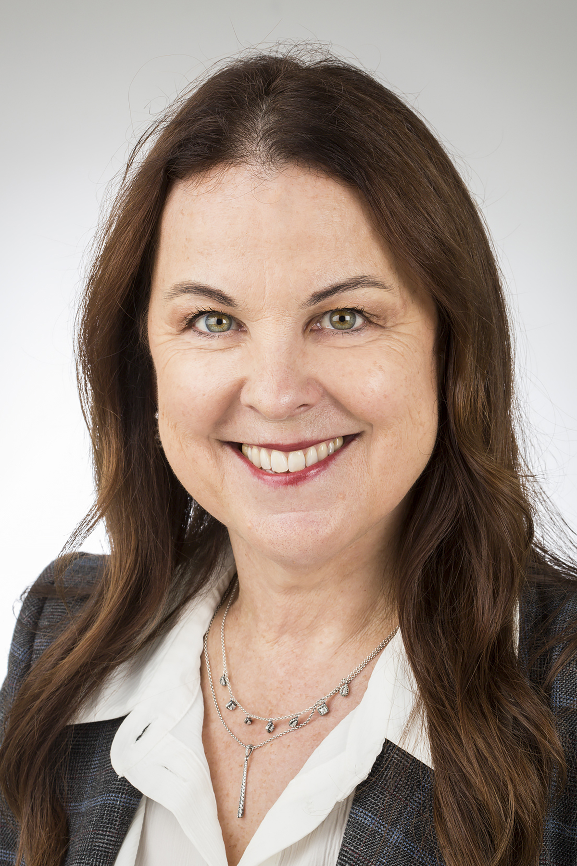
EMHS Chief Executive – Dr Lesley Bennett
Dr Bennett provided an update on key matters across EMHS including:
Changes to the EMHS Area Executive Group, with Sandra Miller commencing in the newly established Executive Director, Mental Health role.
The State Health Operations Centre )SHOC) has set up an Ambulance Co-Response service with EMHS commencing as the pilot site.
Aboriginal Artwork has been commissioned for the RPH buildings located on Lord Street.
EMHS Site Updates
Armadale Kalamunda Group (AKG)
Mr Ajay Sidhu – A/Executive Director AKG provided an update on matters this month:
Ms Naomi Cyrus (AKG PSS) received the Women in Leadership Award at the WA African Communities Awards.
Ligature Remediation Works have commenced in Moodjar Ward.
There were three AKG finalists in the WA Health Excellence Awards.
Royal Perth Bentley Group (RPBG)
Mr Ben Noteboom – Executive Director RPBG provided an update on matters this month:
Next Step Services transition is on track for 18 November 2024.
The Bentley Hospital Midwifery Birth Centre is now due for completion in December 2024.
Aboriginal Health Liaison Officer (AHLO) Kim Hawkett named Aboriginal Allied Health Professional of the Year at the WA Excellence in Allied Health Awards.

