Slide 1
December 2024
EMHS Board Communique
The latest news, views, and announcements
This communique highlights key discussions and considerations of the EMHS Board meeting held on Tuesday 17 December 2024 at EMHS Chief Executive Office.
Board Members Present:
Dr Denise Glennon, A/Board Chair
Mr Ross Keesing, Board Member
Mr Peter Forbes, Board Member
Ms Vanessa Elliott AM via Teams, Board Member
Mr Andrew Whitechurch, Board Member
Ms Elizabeth Koff, Board Member
Noongar Season: Birak

Slide 2
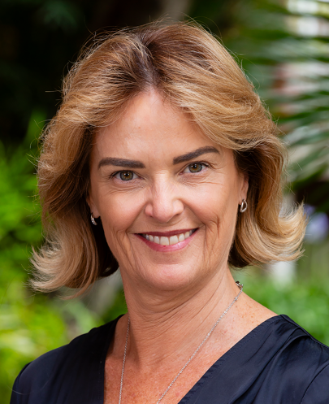
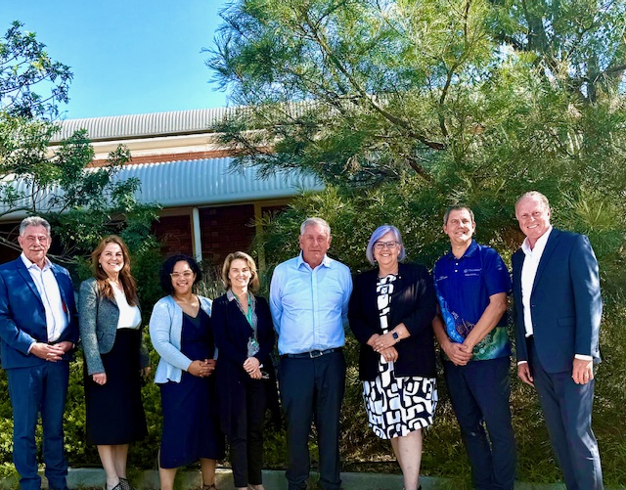
Acting Board Chair – Dr Denise Glennon
In the absence of Board Chair, Ms Pia Turcinov, the Deputy Board Chair, Dr Denise Glennon provided updates on the following key matters:
Ms Turcinov attended the Minister for Health Monthly Ambulance Ramping Taskforce meeting, where updates were received on the Ambulance Mental Health Co-Response, Demand and Capacity Optimisation and Aged Care.
The EMHS Board Members completed their EMHS Board Governance and Code of Conduct Annual Refresher Training with the EMHS Integrity and Ethics team in attendance.
Under Commissioner’s Instruction 40 – Ethical Foundations all Board Members are required to complete formal and planned integrity training on its Code of Conduct every year.
The training covered the four (4) Standards of Conduct, Declarations of Conflicts of Interest and Duty and Information Management Requirements.
EMHS Board Committee Reports
The Board discussed reports from the Chair of the Board Audit & Risk Committee:
Board Audit & Risk:
The Committee was provided with an update on EMHS Cyber Security activities covering off Cyber Security Improvement Initiatives, Incident Response Activities, Essential 8 Compliance Status and Key Performance Indicators.
Updates on the proposed Systemwide Enterprise Risk Management System.
An update was provided on the status of the 2024/25 Audit Plan and audit recommendations.
Left to right: Mr Ross Keesing - Board Member, Dr Lesley Bennett – Chief Executive, Ms Melissa Grove – Board Member, Dr Denise Glennon – Deputy Board Chair, Mr Peter Forbes – Board Member, Ms Pia Turcinov – Board Chair, Mr Neil Cowan – Executive Director, AKG, Mr Andrew Whitechurch – Board Member

Slide 3
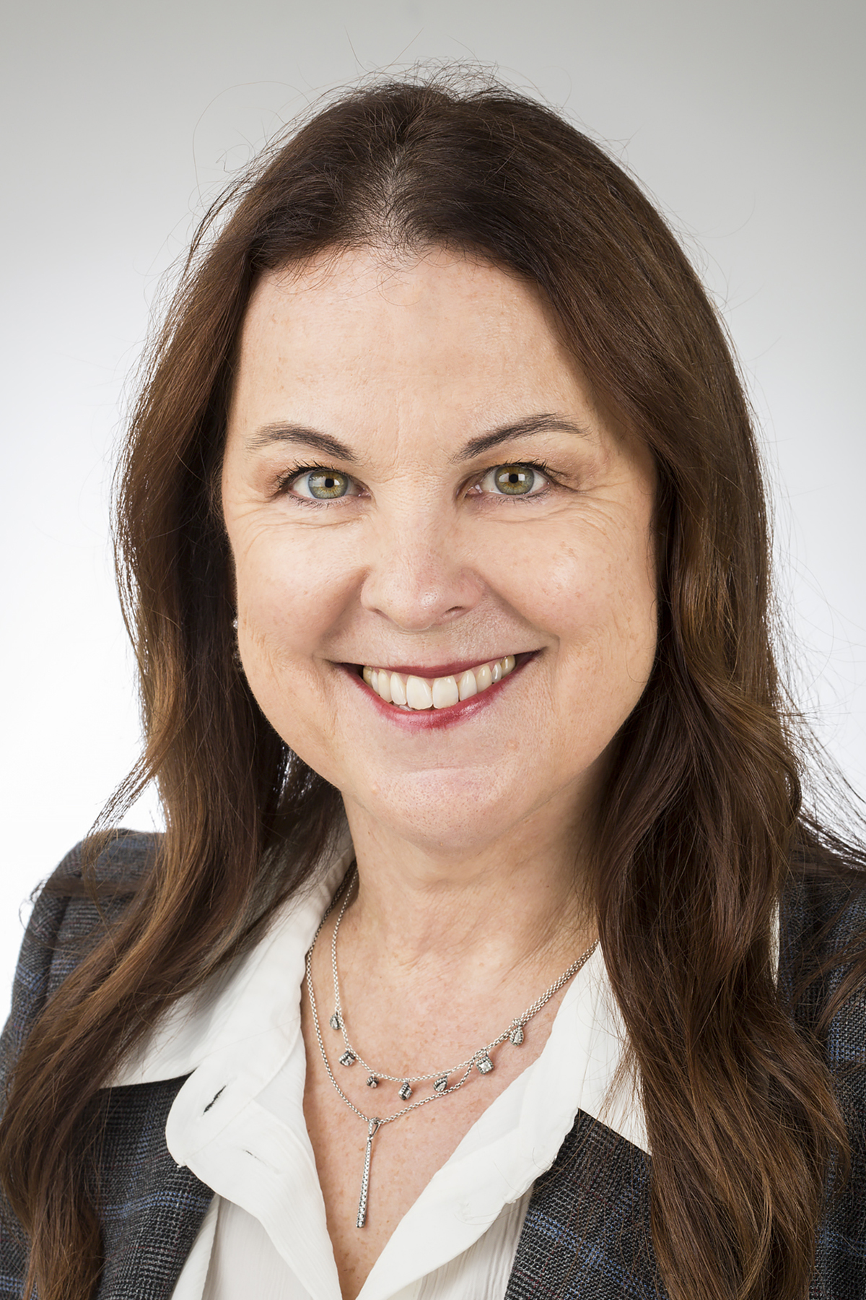
EMHS Chief Executive – Dr Lesley Bennett
Dr Bennett provided an update on key matters across EMHS including:
The Minister for Medical Research, Stephen Dawson, officially opened the EMHS Innovation Hub. The new space features collaborative co-working zones, a prototyping lab equipped with 3D printing facilities and space for the use of new technology such as virtual reality.
The Premier and Minister for Health officially opened the Bentley Hospital Midwifery Birth Centre, a first for public hospitals in WA, the service is led and entirely staffed by credentialed and endorsed midwives.
EMHS Site Updates
Armadale Kalamunda Group (AKG)
Mr Neil Cowan – Executive Director AKG provided an update on matters this month:
AKG have reinstated the Clinical Service Improvement Program at AHS. There are currently Allied Health, Nursing staff and junior doctors working on the Service Improvement Program.
Royal Perth Bentley Group (RPBG)
Mr Ben Noteboom – Executive Director RPBG provided an update on matters this month:
Secure Extended Care Unit (SECU) planning and refurbishment works being conducted in Ward 2K
RPBG are exploring opportunities to work with Derbarl Yerrigan to deliver specialist clinics.
A message to our staff
On behalf of the Area Executive Group (AEG) and EMHS Board, we would like to acknowledge the achievements, dedication and commitment demonstrated by the EMHS staff. Thank you for a wonderful year and we look forward to seeing what 2025 brings.
EMHS Chief Executive – Dr Lesley Bennett
Board Chair – Ms Pia Turcinov

