Slide 1
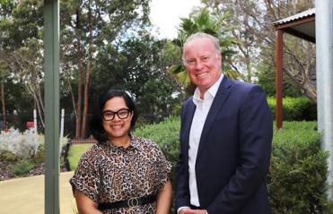
September 2024
EMHS Board Communique
The latest news, views, and announcements
This communique highlights key discussions and considerations of the EMHS Board meeting held on Tuesday 24 September 2024 at Kalamunda Hospital Location.
Board Members Present:
Ms Pia Turcinov AM, Board Chair
Dr Denise Glennon, Deputy Board Chair
Mr Ross Keesing, Board Member
Mr Peter Forbes, Board Member
Prof. Tracey Moroney, Board Member – via Teams
Ms Melissa Grove, Board Member
Ms Vanessa Elliott AM via Teams, Board Member
Mr Andrew Whitechurch, Board Member
Mr Steven Patchett, Board Member
Ms Elizabeth Koff AM, Board Member – via Teams
Noongar Season: Djilba
Board Leader Rounding across Kalamunda Hospital:
Dr Denise Glennon
Mr Peter Forbes
Mr Ross Keesing
Ms Melissa Grove
Mr Andrew Whitechurch
New Board Members: Ms Melissa Grove and Mr Andrew Whitechurch

Slide 2
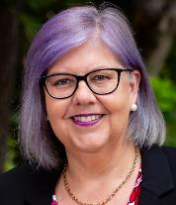
Board Chair – Ms Pia Turcinov
Ms Turcinov attended the Minister for Health Monthly Ambulance Ramping Taskforce Meeting where there were discussions on Emergency Access Reform Program and ED Mental Health presentations.
The Board Chair, Finance Committee Chair, Chief Executive and Executive Director, Finance attended the Office of the Auditor General Exit Meeting.
Ms Turcinov attended a meeting with the Health Service Provider (HSP) Board Chairs and the Minister for Health relating to Ministerial expectations and common challenges raised by HSPs.
Ms Turcinov attended the reopening of the Moort Boodjari Mia Service at St John of God Midland Public Hospital. This service provides a dedicated maternity healthcare and education program for women and their families who identify as Aboriginal or Torres Strait Islander and live in Perth’s East Metropolitan region.
Ms Turcinov held induction meetings with the two new Board Members, Ms Melissa Grove and Mr Andrew Whitechurch and welcomed them to the EMHS Board.
EMHS Board Committee Reports
The Board discussed reports from the Chairs of the Board Safety & Quality, Board Audit & Risk, Board Operational Performance & Strategy, and Board Finance Committees.
Safety & Quality:
Reporting continues to transition to Statistic Process Control (SPC) Charts and Funnel Plots.
The Committee endorsed progression of the Governing Body Attestation Statement Against the Australian Commission on Safety and Quality in Health Care Standards (ACSQHS) to the Board for approval.
Audit & Risk:
The Committee received a comprehensive summary of all internal audit activity.
The Committee endorsed the proposed 2024/25 Internal Audit Plan.
Operational Performance & Strategy:
Smart EMHS sets the overall direction for change and implementation of digital initiatives within EMHS – a refresh of the targeted projects for the next 2 years is nearing completion.
Finance:
The Committee discussed the EMHS financial matters for the month.
An update on EMHS Workers Compensation and Injury Management was provided to the Committee.

Slide 3
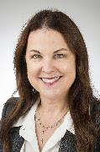
EMHS Chief Executive – Dr Lesley Bennett
Dr Bennett provided an update on key matters across EMHS including:
Completion of the 2023/24 Financial Year Coding on 20 September 2024.
Update on forward planning to refresh the EMHS Strategic Plan in 2025.
EMHS Site Updates
Armadale Kalamunda Group (AKG)
Ms Dan Kilmurray – A/Executive Director AKG provided an update on matters this month:
Armadale Hospital had the highest admissions in September since August 2021 and the highest number of Emergency Department presentations since December 2021.
The plan to upgrade Digital Medical Record is still progressing.
The Minister for Health and Mental Health visited Kalamunda Hospital.
Royal Perth Bentley Group (RPBG)
Mr Ben Noteboom – Executive Director RPBG provided an update on matters this month:
Frontline Leadership session was held on 3 September, focussing on organisational response to critical incidents.
Positive outcomes reported from ‘Choosing Wisely’ initiatives, including cost savings from reduction in unnecessary tests.
Seven finalists in the inaugural WA Excellence Allied Health Awards
Transition of Next Steps Services to EMHS is progressing and is currently planned for November 2024.

